Slide 1
Primo VE NDE
Live Demo of key features
in the Primo VE NDE User Interface
Yoel Kortick
Yoel.Kortick@clarivate.com

Slide 2
Agenda
  Testing the NDE (Next Discovery Experience)
  Enhanced User Area and User Area Menu
  Language Drop Down Menu
  Search Area
  Advanced Search
  Resource Types Filter Bar
  Facets and Filters
  Brief Record Display and Record Actions
  Full Record Display
  Request Forms
  Collection Discovery

Slide 3
Introduction

Slide 4
The Next Discovery Experience – Live Demo
This presentation
  Is designed to be accompanied by a live demonstration but can also be viewed as a "standalone"
  Will focus on what has been developed in the new Primo VE NDE (Next Discovery Experience)
  In addition to this live demo, it is recommended to see also: Overview of the NDE Interface and Configuration
Note that because development of the Primo VE NDE is still in process, functionality showed during this live demo is subject to change.
Regarding the rollout of the new Primo VE NDE see:
  Primo NDE UI Rollout Explained webinar – March 2025 (YouTube)
  When will the NDE UI be rolled out?
  Available Features, Functionality and Release Plan for NDE UI
  Next Discovery Experience (NDE)

Slide 5
Testing the Next Discovery Experience
While using the current Discovery Interface

Slide 6
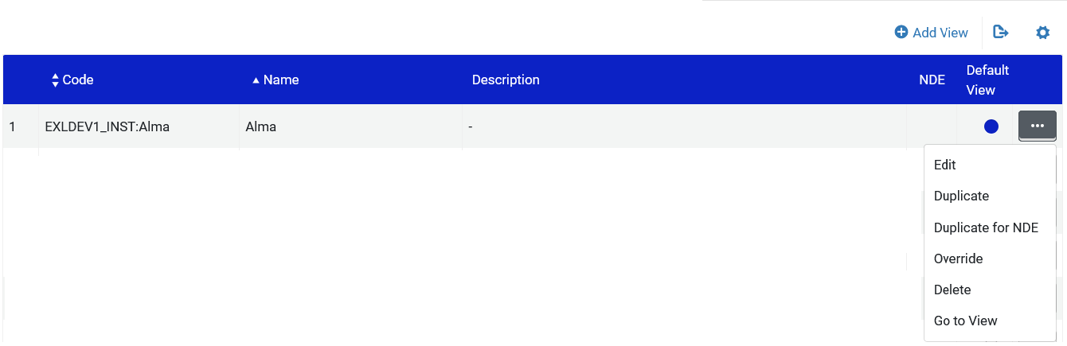
Testing the Next Discovery Experience
The Next Discovery Experience can be tested by duplicating an existing Primo VE View

Slide 7
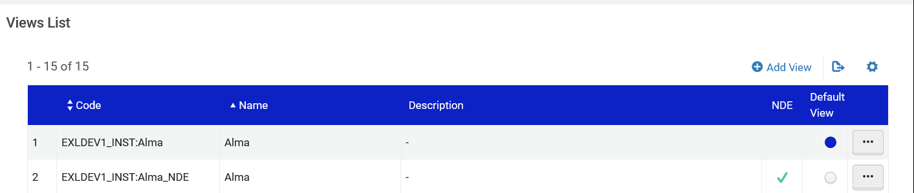
Testing the Next Discovery Experience
The Primo VE View will be duplicated

Slide 8
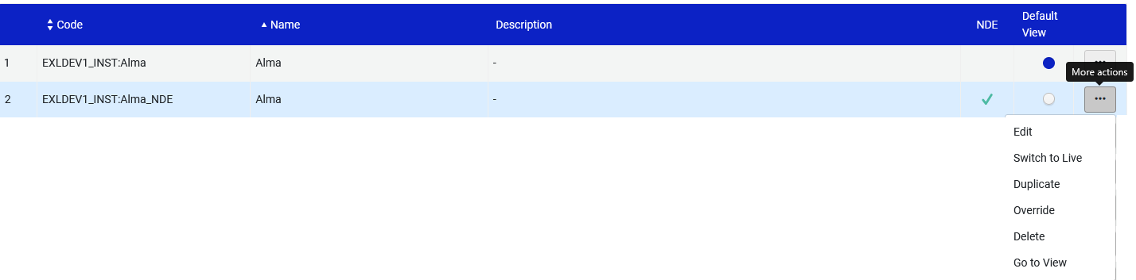
Testing the Next Discovery Experience
The new Primo VE NDE View will be available and fully functional.
Choose action item "Go to View" to see the Primo VE NDE View

Slide 9
Enhanced User Area and User Area Menu

Slide 10
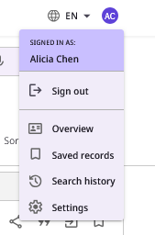
Enhanced User Area and User Area Menu
Logged in use clicks the initials on top right
Enhanced User Area.
By default, the following options are active and appear in the following order:
The Sign in/Sign out option is enabled by default and appears at the top of the menu.
Overview - Opens the Overview section (which highlights the user's Loans, Requests, Fines and Fees, Saved Records, and Search History). Requires user sign-in.
Saved Records
Search History
Settings - Requires user sign-in.
We will now click "Overview"

Slide 11
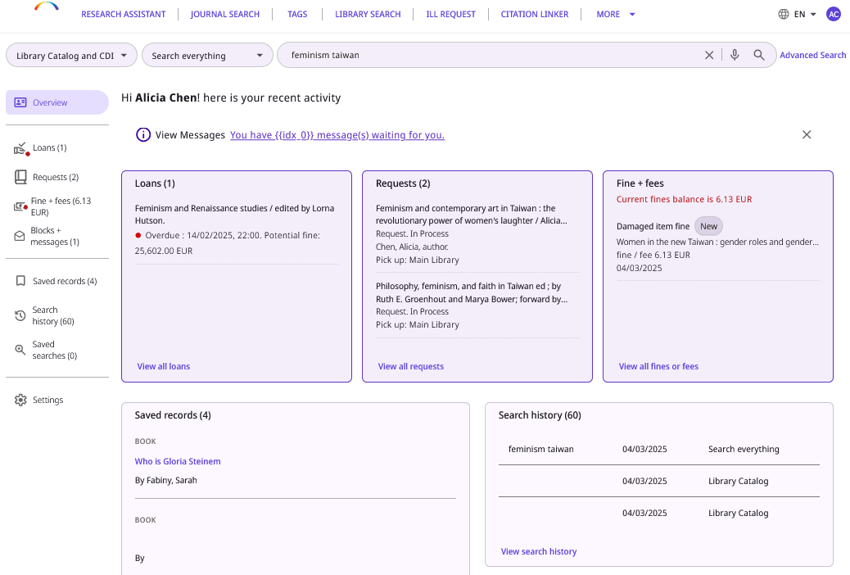
Enhanced User Area and User Area Menu
The Overview User Area in the NDE UI includes both Library Card Activities as well as saved records and searches:
  My Library Card activities
    Loans
    Requests
    Fines & Fees
    Blocks & Messages
  Saved records and searches
    Saved records
    Search history
    Saved searches
Having all this information in one place provides a centralized, user-friendly space for personal management.
Configuration is available to define the options to display in the new User Area.
As with other pages in the NDE UI, the search bar and the header always appear at the top of the page.
All in one place

Slide 12

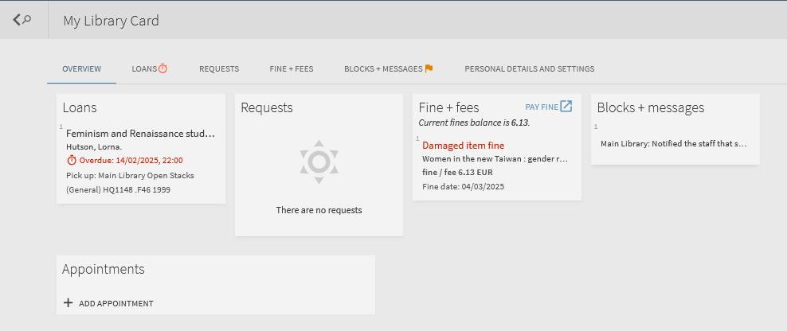
Enhanced User Area and User Area Menu
Previously with Primo VE, the Library Card Activities as well as saved records and searches were in separate locations.

Slide 13
Language Drop Down Menu

Slide 14
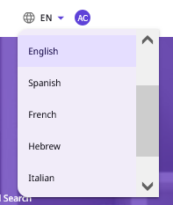
Language Drop Down Menu
Users can easily change the UI’s interface language from the Main Menu Bar (if the environment supports multiple languages).
When the language is changed via this method, it is retained for the session (and not as part of the user’s profile)

Slide 15
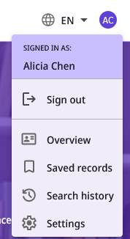
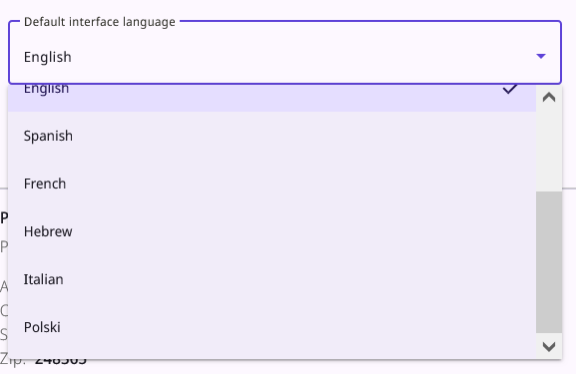
Language Drop Down Menu
The interface language can also be changed via the settings (when logged in)
This method saves the language preference for the user for all sessions (it becomes part of the user’s profile and thus is saved after logging out and logging in)

Slide 16
Search Area

Slide 17
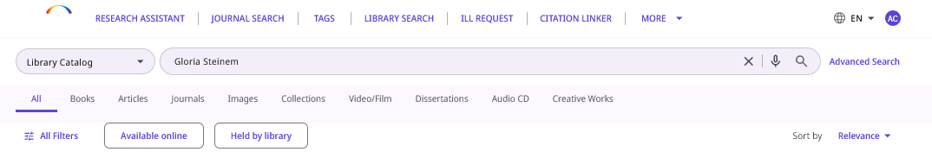
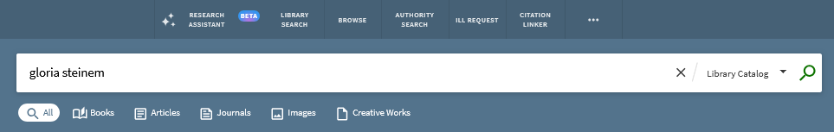
Search Area
The search profiles have been relocated to appear prominently on the left of the search bar.
Previously with Primo VE, the profiles were off to the right, far away from where the user entered his or her search text

Slide 18
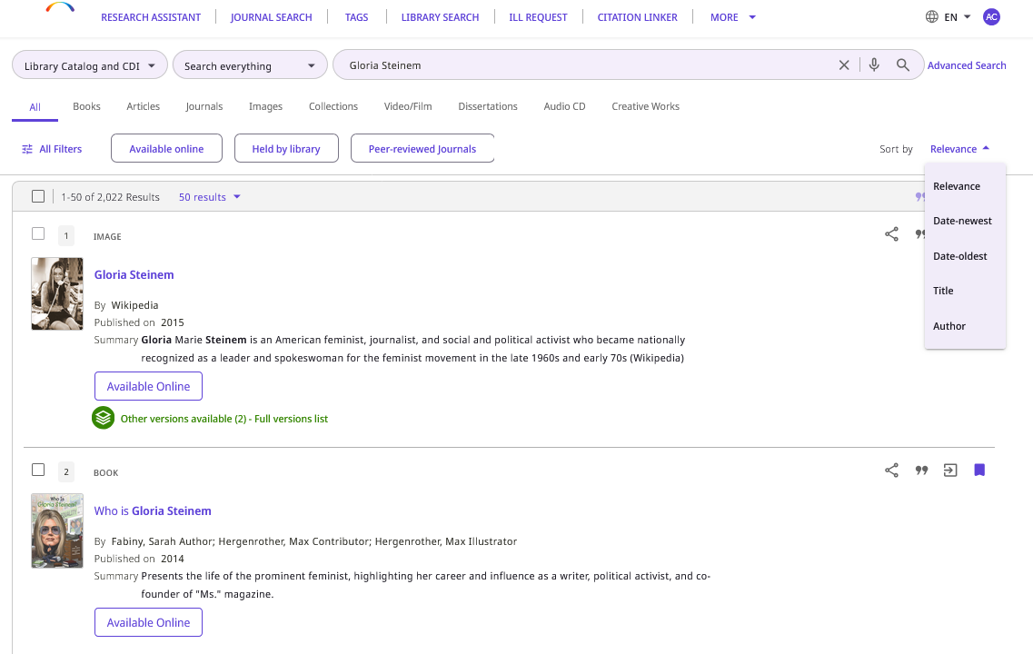
Search Area
The search results can be sorted
The link to sorting appears in a prominent place

Slide 19
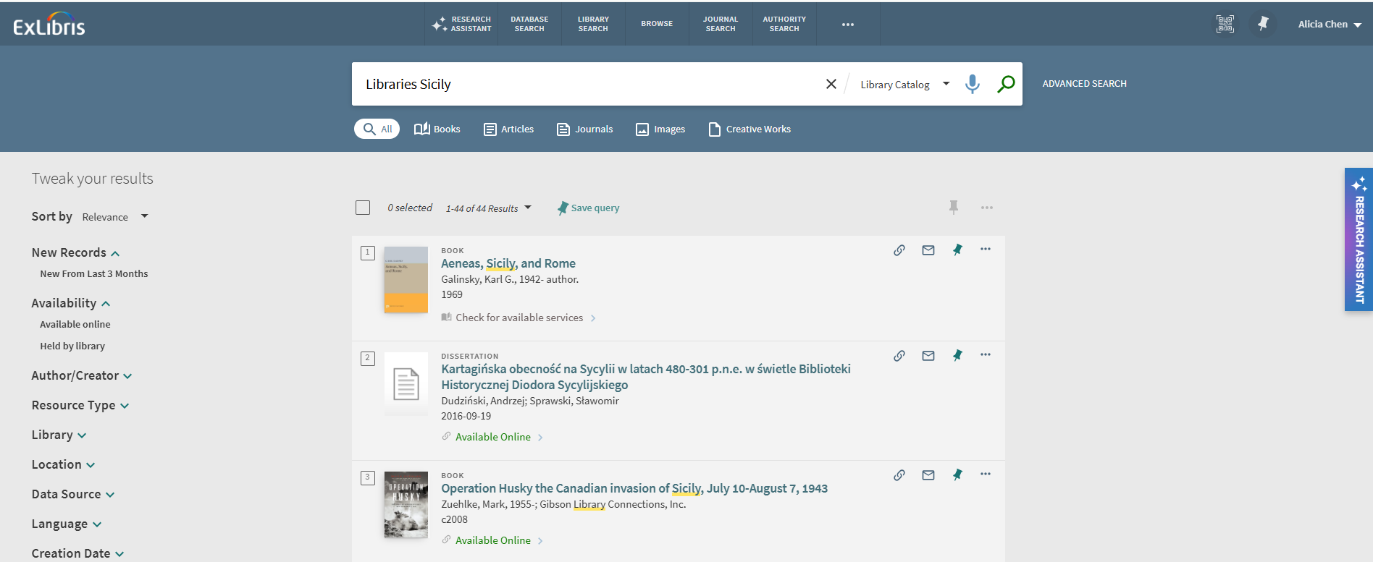
Search Area
Previously with Primo VE, the link to sort was hidden off to the left.

Slide 20
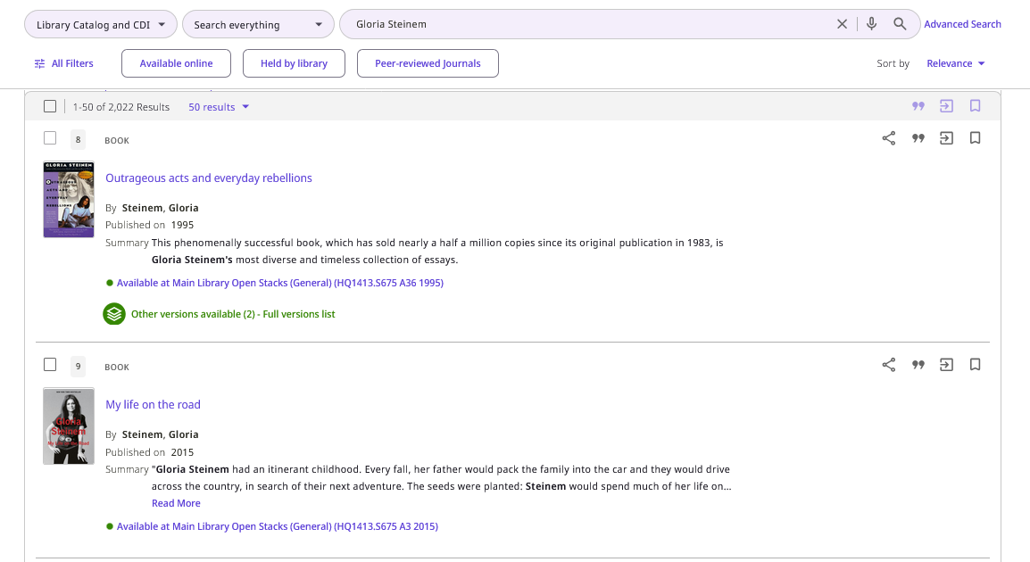
Search Area
The search bar and facets line remain fixed at the top of the search results during scrolling.
This ensures prominent access to search and filtering options.

Slide 21
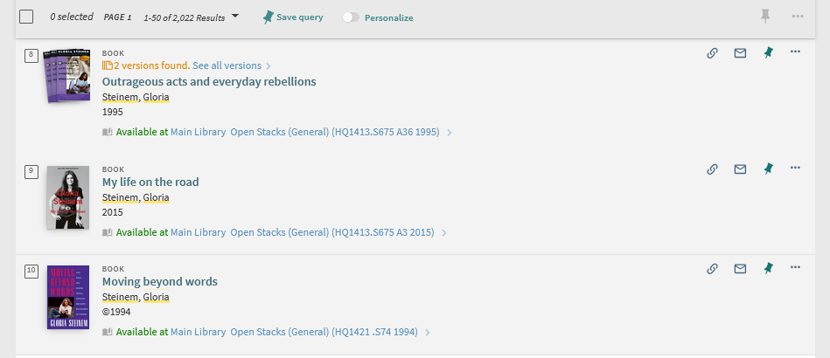
Search Area
Previously with Primo VE, the search bar "scrolled off the screen".
As a result, prominent access to search options was removed from the search results.

Slide 22
Advanced Search

Slide 23
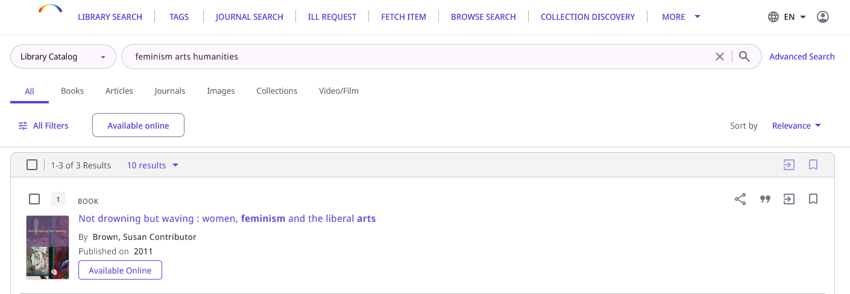
Advanced Search
We will now access the Advanced Search

Slide 24
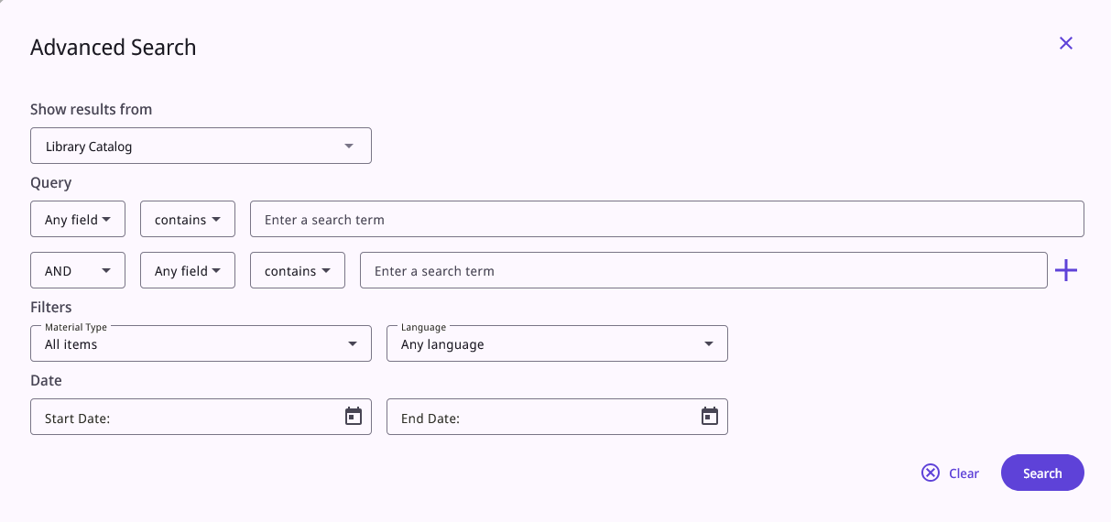
Advanced Search
A new Advanced Search form appears

Slide 25
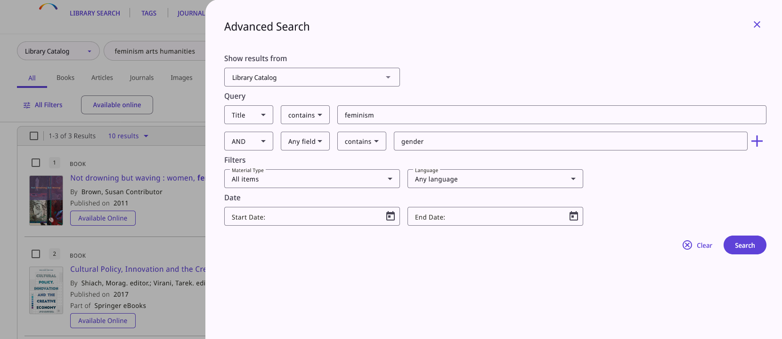
Advanced Search
The Advanced Search form is opened as a slide panel on the side of the current page in the UI.
This provides increased visibility of search results after searching in Advanced Search.

Slide 26
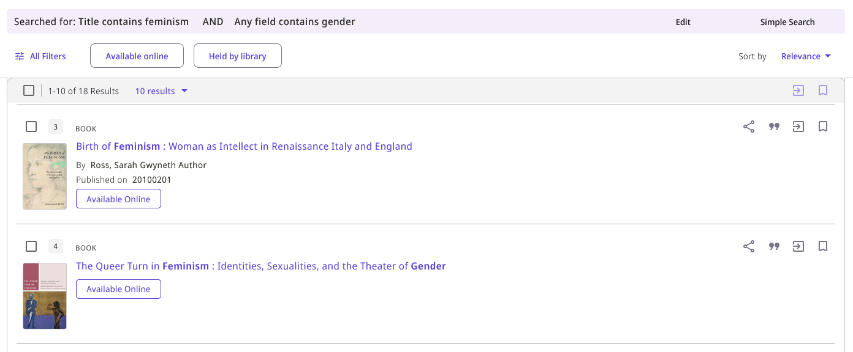
Advanced Search
The Advanced Search query remains on top when scrolling through the results.
From the Advanced Search results the search query can be edited and run again

Slide 27
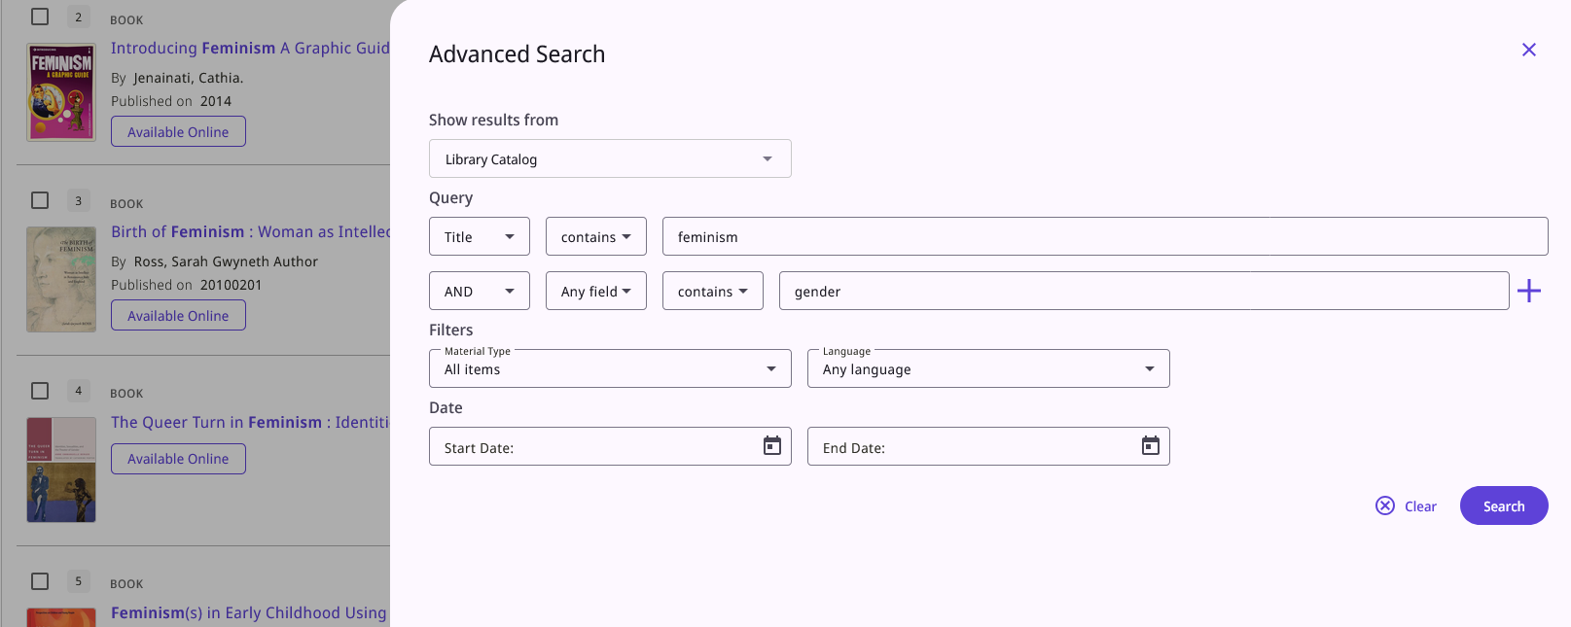
Advanced Search
After clicking "Edit" from the Advanced Search results the search query appears with the most recently used search parameters.
It can then be modified (if desired) and run again.

Slide 28
Resource Types Filter Bar

Slide 29
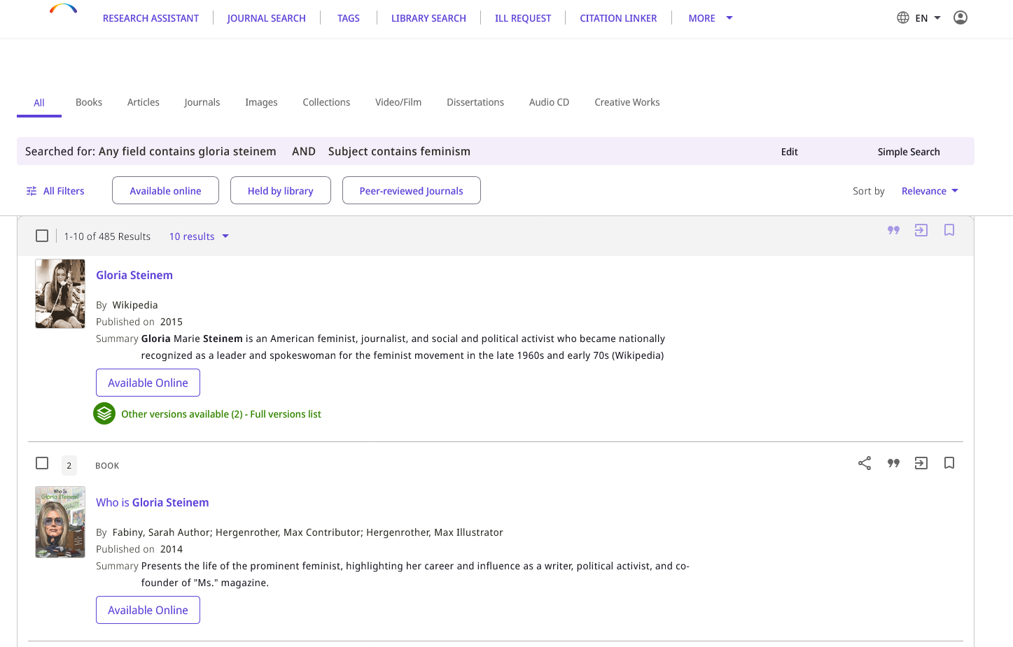
Resource Types Filter Bar
The Resource Type Filter Bar appears in both the Simple and Advanced Search.
This allows users to quickly and easily filter their results by resource types.
Previously with Primo VE, this option existed only from the Simple Search.

Slide 30
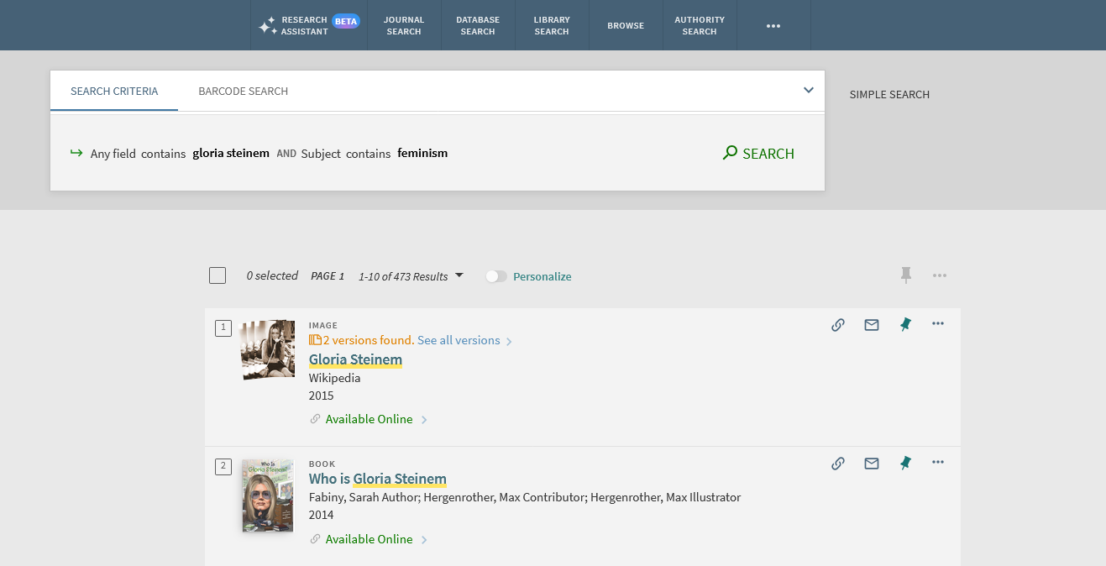
Resource Types Filter Bar
Previously with Primo VE, the Resource Type Filter Bar appeared in Simple but not in Advanced Search
In Primo VE NDE, the Resource Type Filter Bar appears in Simple Search and Advanced Search

Slide 31
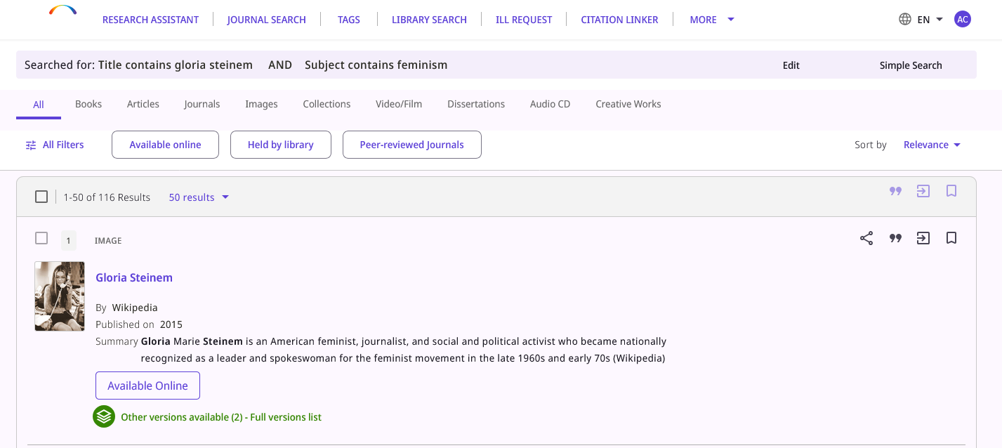
Resource Types Filter Bar
Here in Primo VE NDE we see the Resource Type Filter Bar appearing in the Advanced Search

Slide 32
Facets and Filters

Slide 33
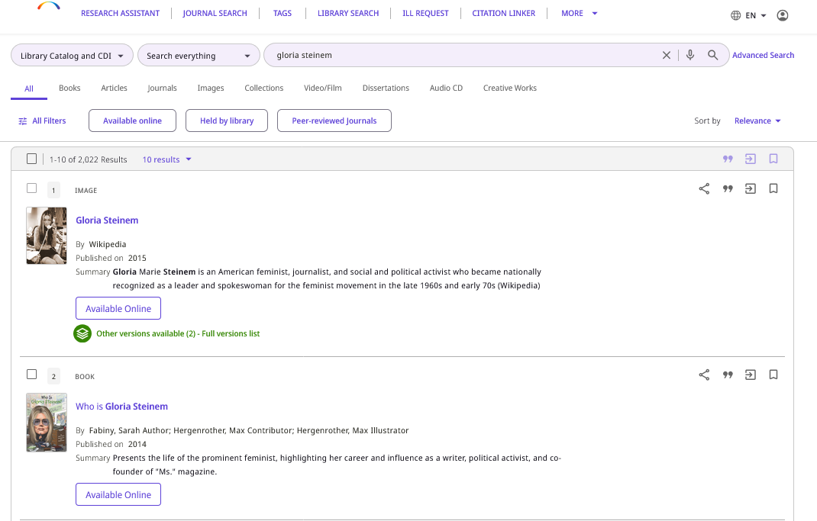
Facets and Filters
The facets are
  Closed by default
  Appear below the Resource Types Filter Bar

Slide 34
Facets and Filters
Quick Filters – configurable quick filters for top level facets such as "Available online" and "Held by library"
Additional filters are closed by default and can be opened to the side pane by clicking "All Filters".

Slide 35
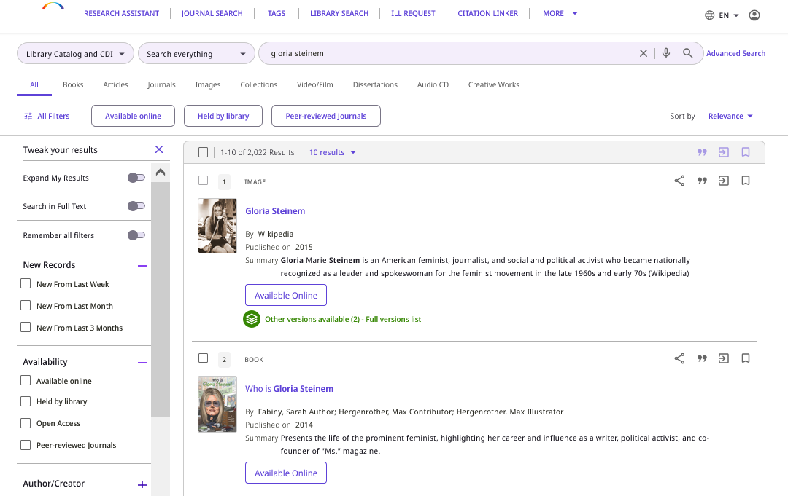
Facets and Filters
After clicking "All Filters" additional facets are opened in the side pane.

Slide 36
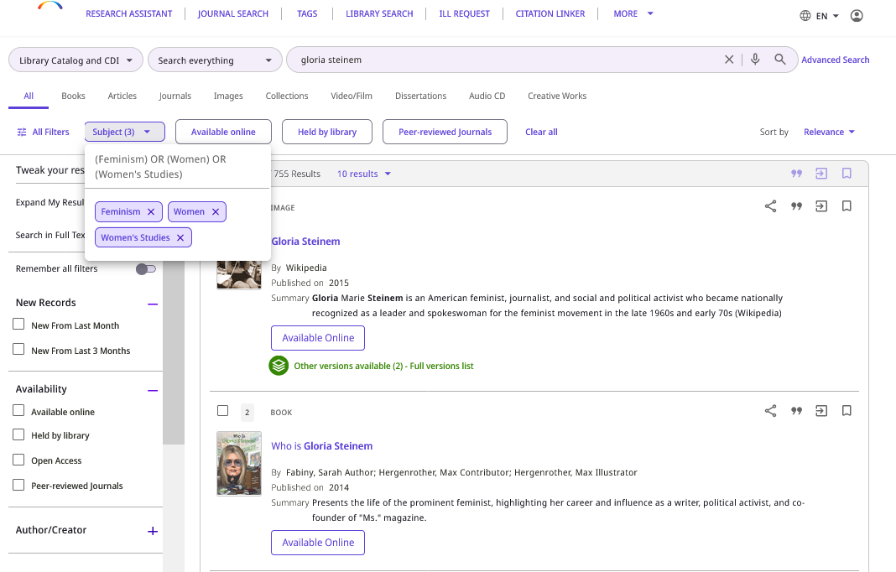
Facets and Filters
The summary for a selected facet now includes the Boolean operation between selected values
This provides the user with a clear summary of the facet's scope
In this case we see that Subjects has been faceted by "(Feminism) OR (Women) OR (Women's Studies) "

Slide 37
Brief Record Display and Record Actions

Slide 38
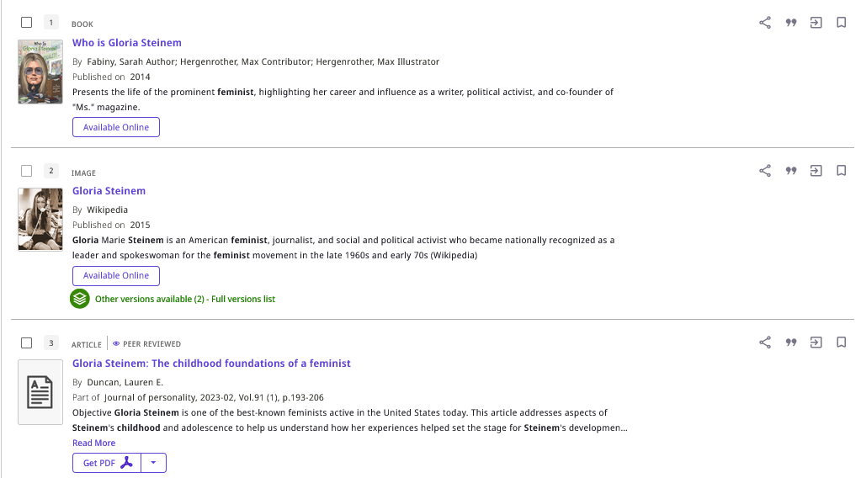
Brief Record Display and Record Actions
Descriptive labels (such as, but not only, "By", "Published on" and "Part of") have been added to the display lines.
(More about the "Summary" field soon.)

Slide 39
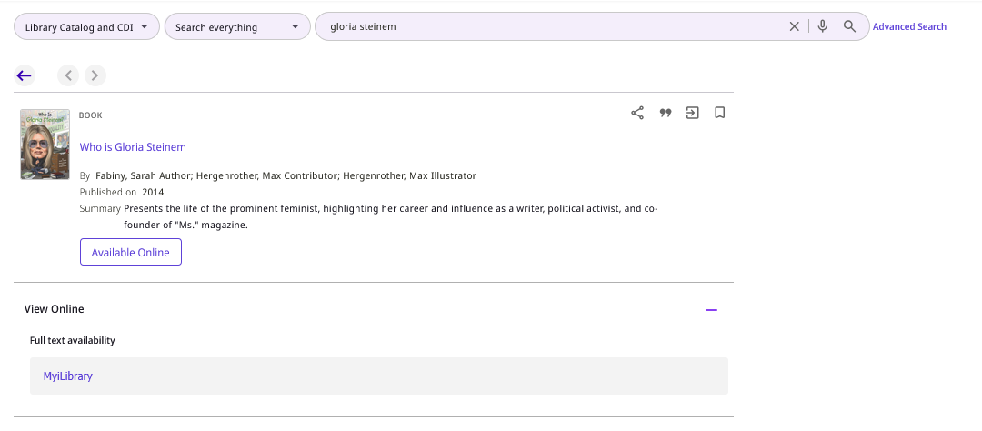
Brief Record Display and Record Actions
The descriptive labels also appear at the top of the record's Full Display page

Slide 40
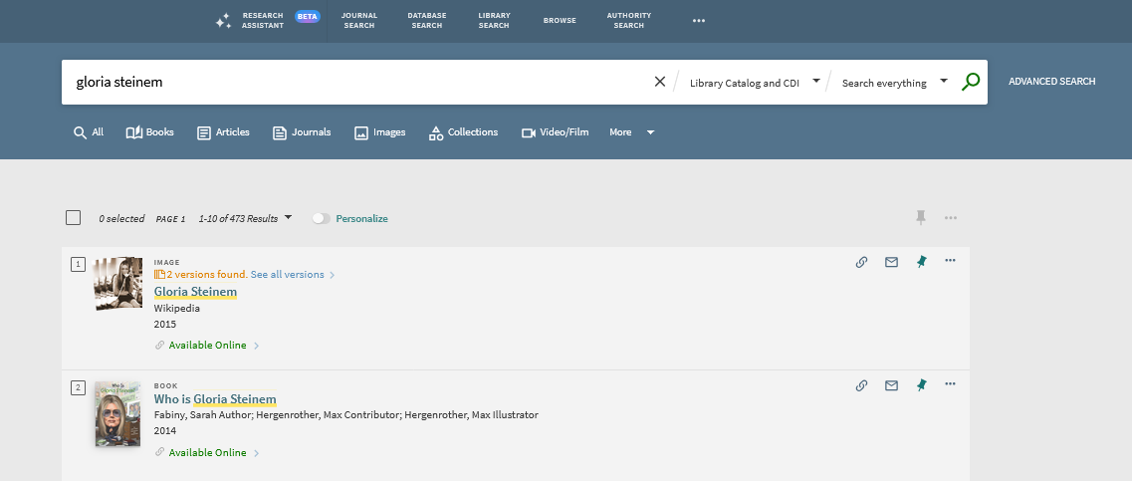
Brief Record Display and Record Actions
Previously with Primo VE, there were no descriptive labels
No labels

Slide 41
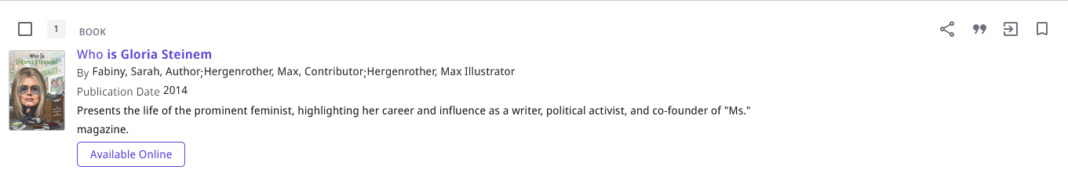
Brief Record Display and Record Actions
The "Summary"
On the next slide we will see how it can be configured to appear or not appear.

Slide 42
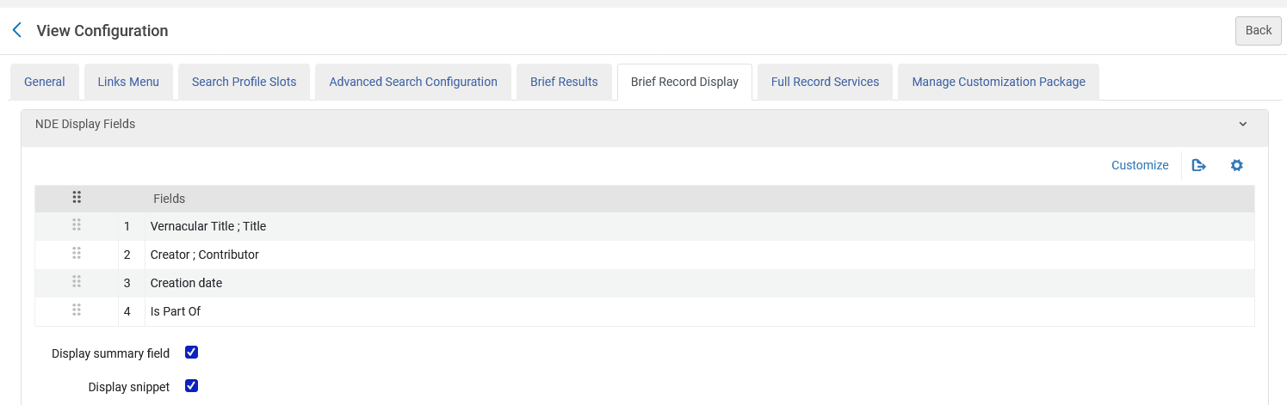
Brief Record Display and Record Actions
View Configuration
Includes summary

Slide 43
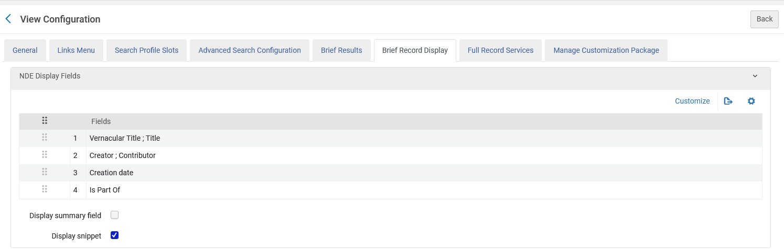
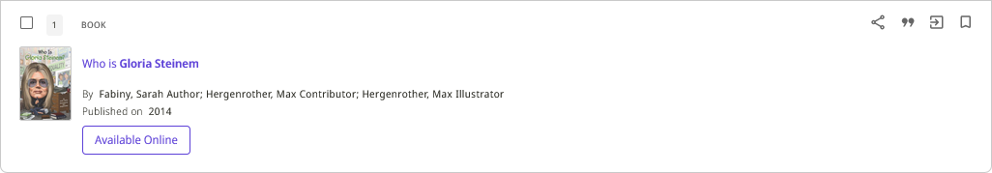
Brief Record Display and Record Actions
View Configuration
No summary

Slide 44
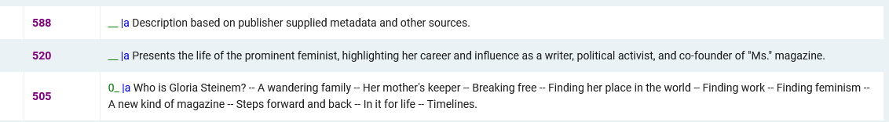
Brief Record Display and Record Actions
Here we see that the summary is coming from the 520 (summary field), in the case of a MARC21 record)

Slide 45
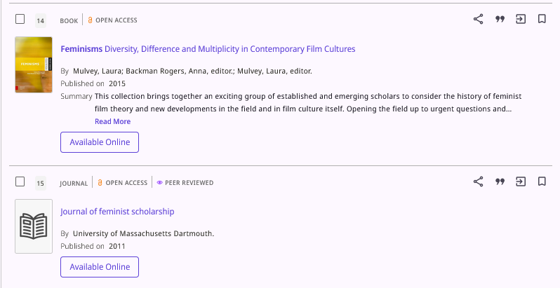
Brief Record Display and Record Actions
Record indicators (such as Open Access and Peer Reviewed) are now grouped prominently at the top next to the record's resource type.

Slide 46
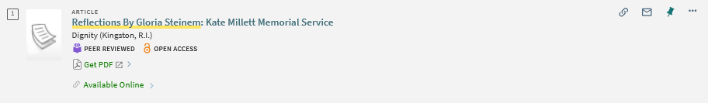
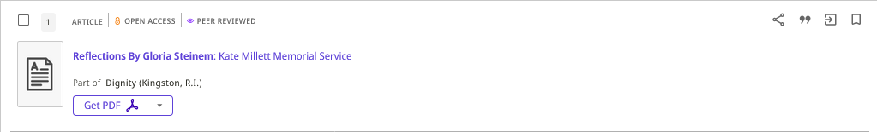
Brief Record Display and Record Actions
The previous Primo VE interface
The new Primo VE NDE interface

Slide 47
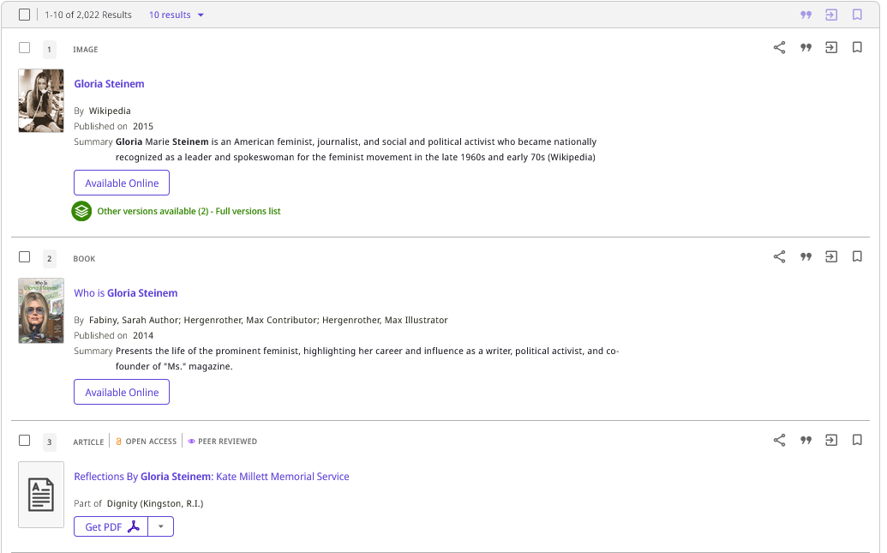
Brief Record Display and Record Actions
Each brief record contains links for "Record Actions".
Record actions are grouped by the following categories and displayed on top: Share, Citations, Export, and Favorites.

Slide 48
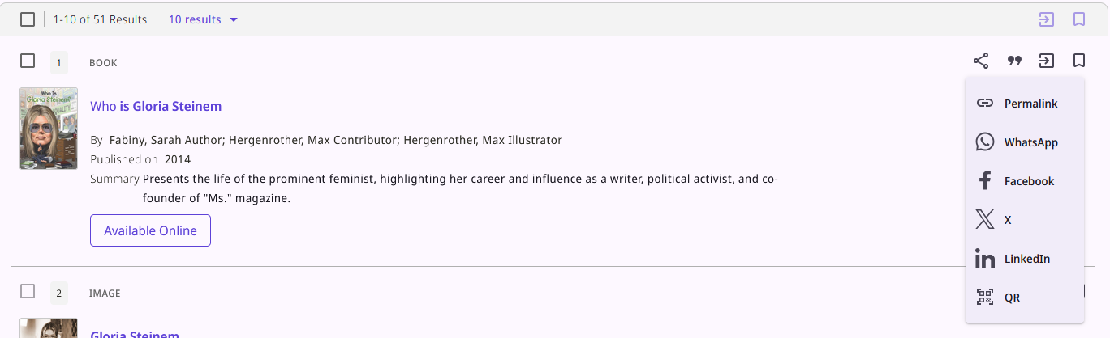
Brief Record Display and Record Actions
Click to get all available share options

Slide 49
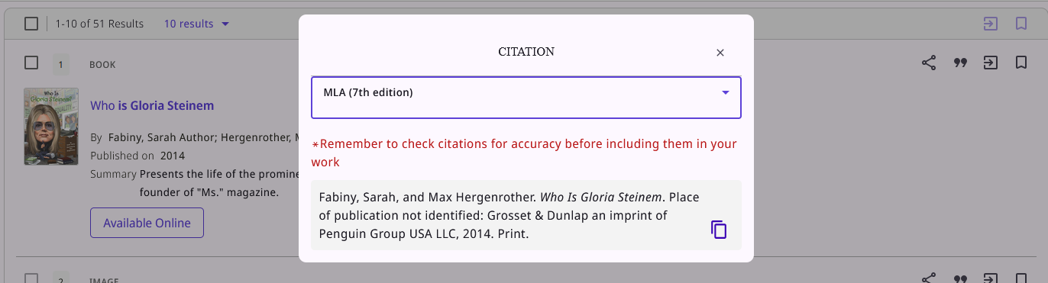
Brief Record Display and Record Actions
Citation

Slide 50
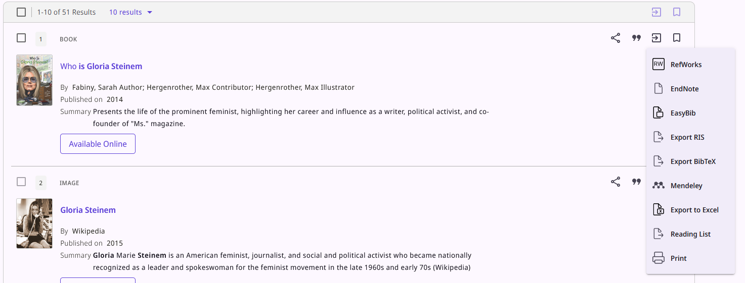
Brief Record Display and Record Actions
Click to get all available export options

Slide 51
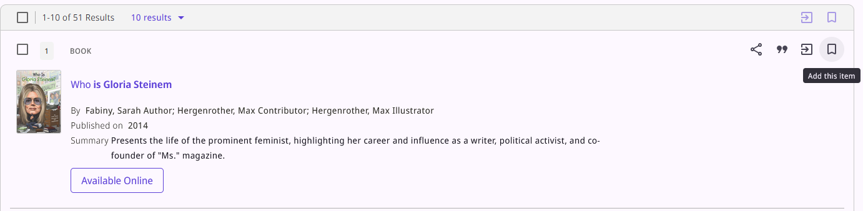
Brief Record Display and Record Actions
Click to add to saved records

Slide 52
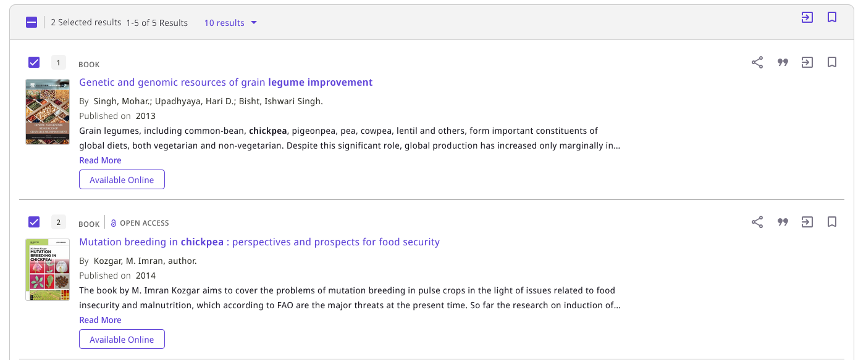
Brief Record Display and Record Actions
Export and Add to saved records can be performed on multiple selected records from search results

Slide 53
Full Record Display

Slide 54
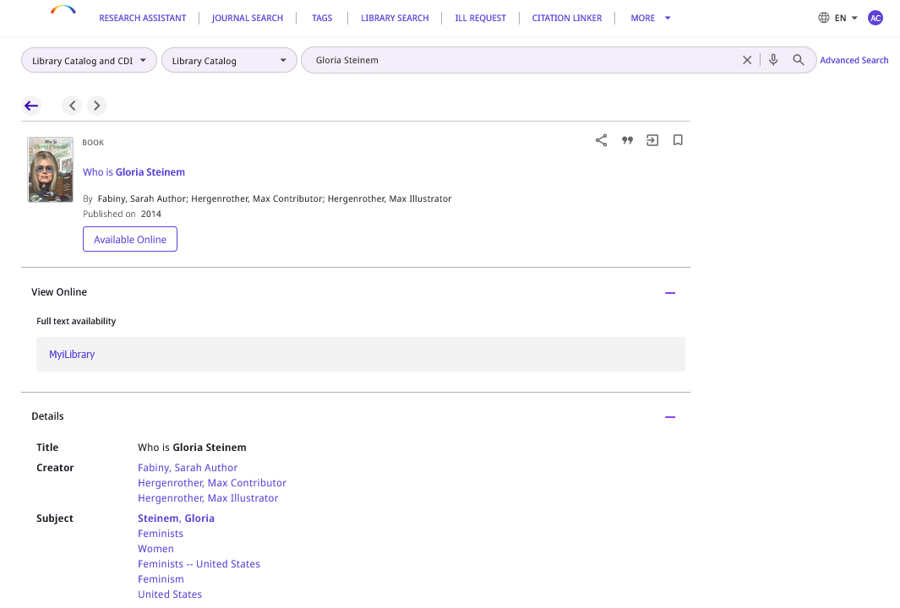
Full Record Display
In the Full Record Display the search bar and main menu links are available at the top of the page.

Slide 55
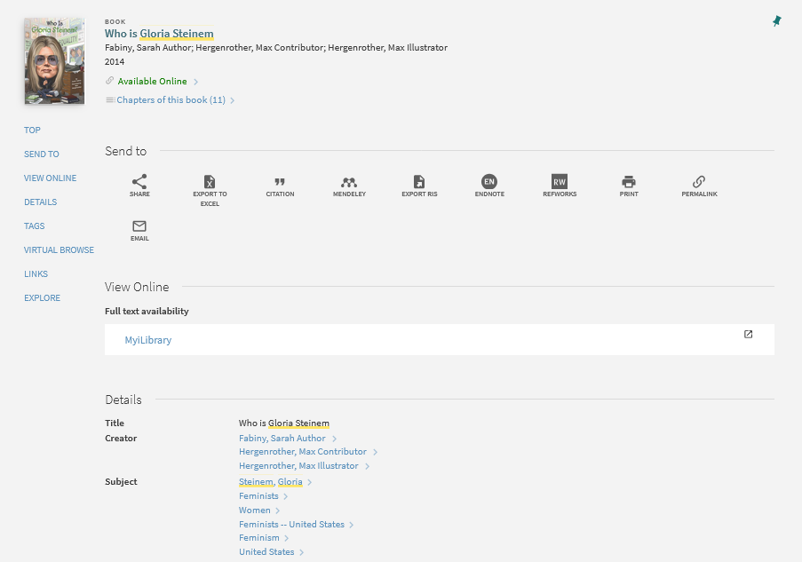
Full Record Display
Previously with Primo VE, in the Full Record Display the search bar and main menu links were not available.

Slide 56
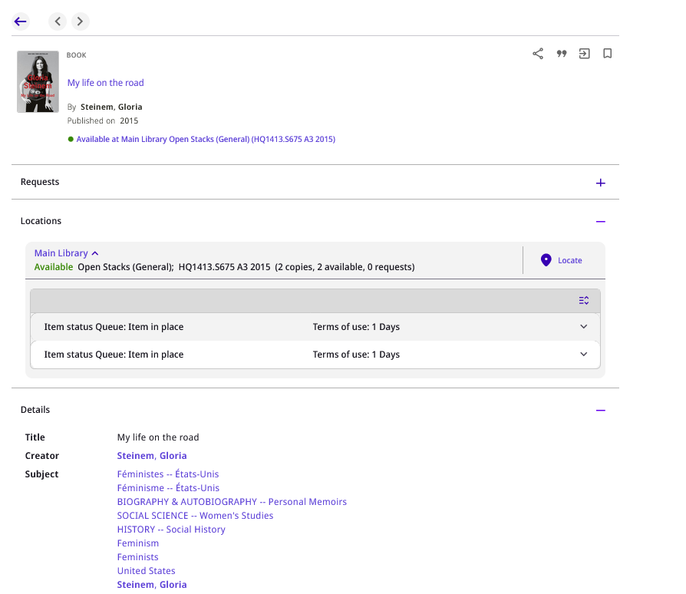
Full Record Display
Users can now expand and collapse sections by selecting the Plus and Minus icons.
Here we have collapsed the "Requests" section and left expanded the "Locations" and "Details"

Slide 57
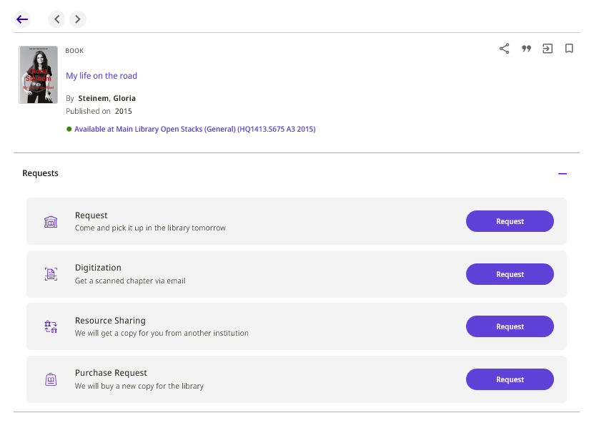
Full Record Display
New Requests Section - Requests have moved from being displayed within the "Get It" services section to a dedicated, more visually distinct area.

Slide 58
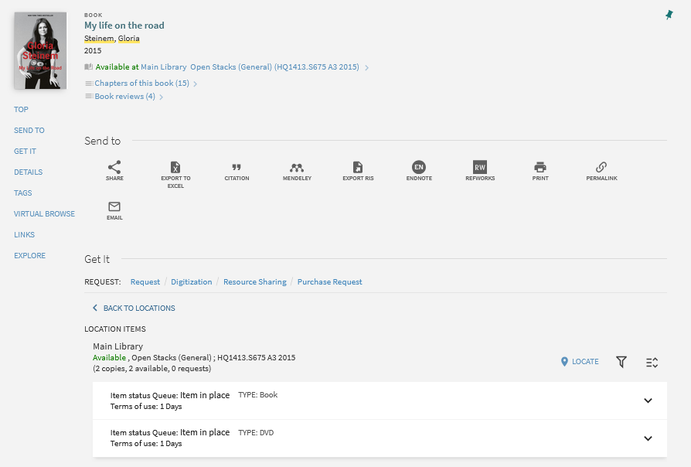
Full Record Display
Previously with Primo VE, requests were being displayed within the "Get It" services section.

Slide 59
Request Forms

Slide 60
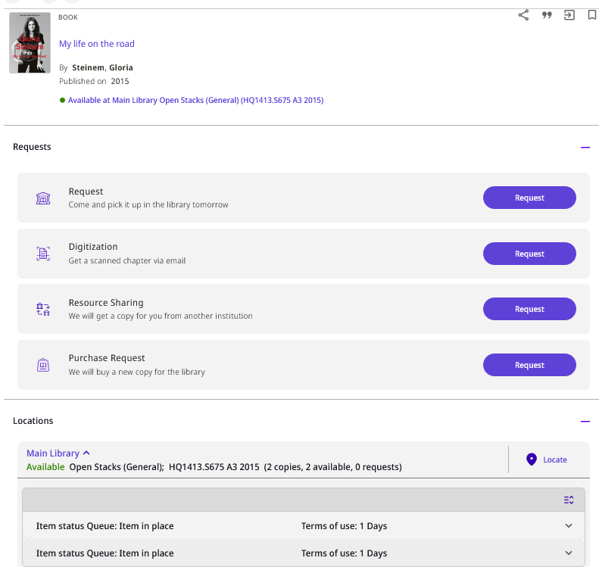
Request Forms
We will click here to see the new Request Form

Slide 61
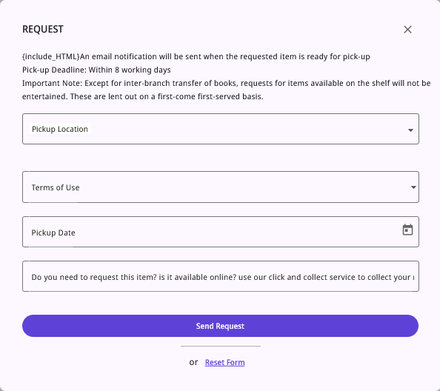
Request Forms
Simplified Request forms - request forms have been simplified, streamlining the process for users to submit their requests quickly and efficiently.

Slide 62

Request Forms
Previously with Primo VE, this is how the request form appeared.

Slide 63
Collection Discovery

Slide 64

Collection Discovery
The new Primo VE NDE Collection Discovery

Slide 65

Collection Discovery
The previous Primo VE Collection Discovery

Slide 66
Collection Discovery
We will now click on the collection "Impressionist Portraits and Paintings" to view the contents of the collection.

Slide 67

Collection Discovery
New option to filter by facets (tentatively scheduled for June 2025)

Slide 68
Collection Discovery
New option for "List View"

Slide 69

Collection Discovery
Here is the "List View"

Slide 70
Collection Discovery
We will now click "Sunset Boats by Claude Monet"

Slide 71

Collection Discovery
The top bar and search bar are "always on top" for easy navigation by the user

Slide 72

Collection Discovery
Previously in Primo VE the user lost the top bar and search bar after viewing the digital object

Slide 73
Collection Discovery
Easy navigation for the user to
Go back to previous results
View the previous object in the collection
View the next object in the collection

Slide 74
Collection Discovery
We will click here to view the next object in the collection which is "Irises by Vincent van Gogh"

Slide 75

Collection Discovery
We have automatically moved to the next object in the collection

Slide 76
Collection Discovery
Search inside the hierarchy of the collections
When performing a search within the collection discovery:
  In the new Primo VE NDE the search looks for objects in the current collection and also in subcollections of the current collection
  Previously in Primo VE the search looked only for objects in the current collection.
For example inside collection "Flowers of Israel" there is a subcollection "Flowers of Israel Bulbs"
  Inside subcollection "Flowers of Israel Bulbs " there is an object "Sternbergia, Sternbergia clusiana"
In the previous Primo VE if we search for "Sternbergia" in the collection "Flowers of Israel" we will not find object "Sternbergia, Sternbergia clusiana" in subcollection "Flowers of Israel Bulbs"
In the new Primo VE NDE if we search for "Sternbergia" in the collection "Flowers of Israel" we will find object "Sternbergia, Sternbergia clusiana" in subcollection "Flowers of Israel Bulbs" (and it will include an indication of the subcollection to which it belongs)

Slide 77

Collection Discovery
Inside collection "Flowers of Israel" there is a subcollection "Flowers of Israel Bulbs"

Slide 78

Collection Discovery
In subcollection "Flowers of Israel Bulbs " there is an object "Sternbergia, Sternbergia clusiana"

Slide 79

Collection Discovery
In the previous Primo VE if we search for "Sternbergia" in the collection "Flowers of Israel" we will not find object "Sternbergia, Sternbergia clusiana" in subcollection "Flowers of Israel Bulbs"

Slide 80

Collection Discovery
In the new Primo VE NDE if we search for "Sternbergia" in the collection "Flowers of Israel" we will find object "Sternbergia, Sternbergia clusiana" in subcollection "Flowers of Israel Bulbs"
It include an indication of the subcollection to which it belongs

Slide 81


Yoel Kortick
Yoel.Kortick@clarivate.com
About Clarivate
Clarivate is a leading global provider of transformative intelligence. We offer enriched data,
insights & analytics, workflow solutions and expert services in the areas of Academia & Government, Intellectual Property and Life Sciences & Healthcare. For more information, please visit clarivate.com.
© 2026 Clarivate. All rights reserved
Clarivate and its logo, as well as all other trademarks used herein are trademarks of their respective owners and used under license.

